Slide 1

DISASTER ALERT & RESCUE MANAGEMENT SYSTEM
The Disaster Alert and Rescue Management System is designed to provide early warnings and coordinates rescue operations during natural disasters such as floods, cyclones, earthquakes, and landslides. The system collects information from weather departments, emergency services, and citizens to generate alerts and manage rescue
activities efficiently. This helps reduce loss of life and property.
“Connecting Lives, Saving Lives.”
Project Title: LifeLink(Disaster Alert & Rescue
Coordination System)
Name: Pragati PritiPrajna, Snehanjali Rout, Ananya Panda, SushreeSuhani Mohapatra
College: Kendrapara Autonomous College

Slide 2
PROBLEM STATEMENT :
People often do not receive timely disaster warnings & emergency assistance during natural disasters such as Floods, Cyclone, Earthquakes & Landslides.
Delayed communication and poor coordination among rescue teams can lead to loss of life & property.
LifeLink aims to provide real-time alerts and connect affeceted people with rescue services quickly.
Late disaster warnings.
Poor communication during emergencies.
Difficulty in locating affected people.
Inefficient coordination between rescue teams & authorities.
Limited information about shelters and relief resources.
WHY DOES THIS PROBLEM EXIST ?

Slide 3
WHO ARE THE STAKEHOLDERS? Internal Users: External Users: Expected Users:
System Administrator
Disaster Management Officer
Rescue Team Leaders
Shelter Manager
Citizens
NGOs
Government Agencies
Volunteers
Weather Department
General Public
Shelter Coordinators
Emergency Response Teams

Slide 4
OBJECTIVES OF THE PROJECT :
To provide real-time disaster alerts.
Emergency offline mode
To help people request emergency assistance.
To improve communication during disasters.
To coordinate rescue operations efficiently.
To manage shelters and relief resources.
To save lives and reduce damage.
To track affected areas and rescue status.
To generate reports for disaster management planning.

Slide 5
EXPECTED OUTPUTS :
Offline rescue team device(Walkie-talkies)
Disaster warning notification & Emergency sirens.
Faster rescue operation.
Shelter location information.
Emergency rescue request.
Quick communication.
Improve public safety.
Disaster Management dashboard.

Slide 6
HANDS-ON ACTIVITY : Strategic Information : Tactical Information : Operational Information :
Disaster preparedness planning.
Planning new shelters in high-risk areas.
Long term risk assessment.
Budget & Resource planning
Monthly rescue team allocation.
Shelter capacity management.
Resource distribution planning.
Training schedules for rescue teams.
Daily disaster alerts sent.
Shelter occupancy status.
Daily weather monitoring.
Rescue team location tracking.
Rescue request received.

Slide 7
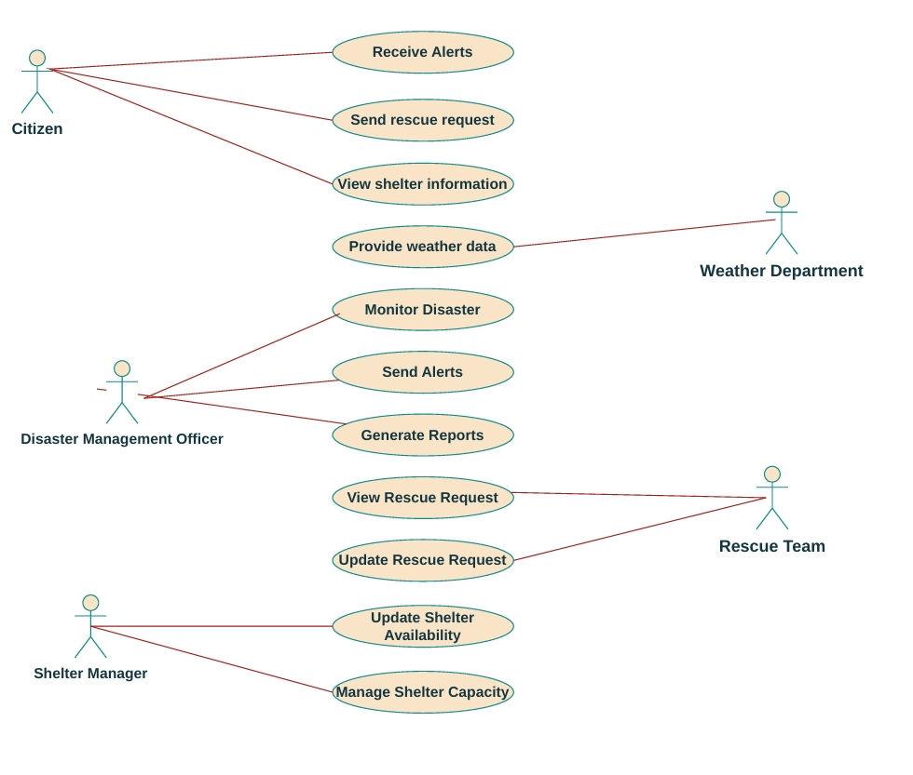
USE CASE DIAGRAM :

Slide 8
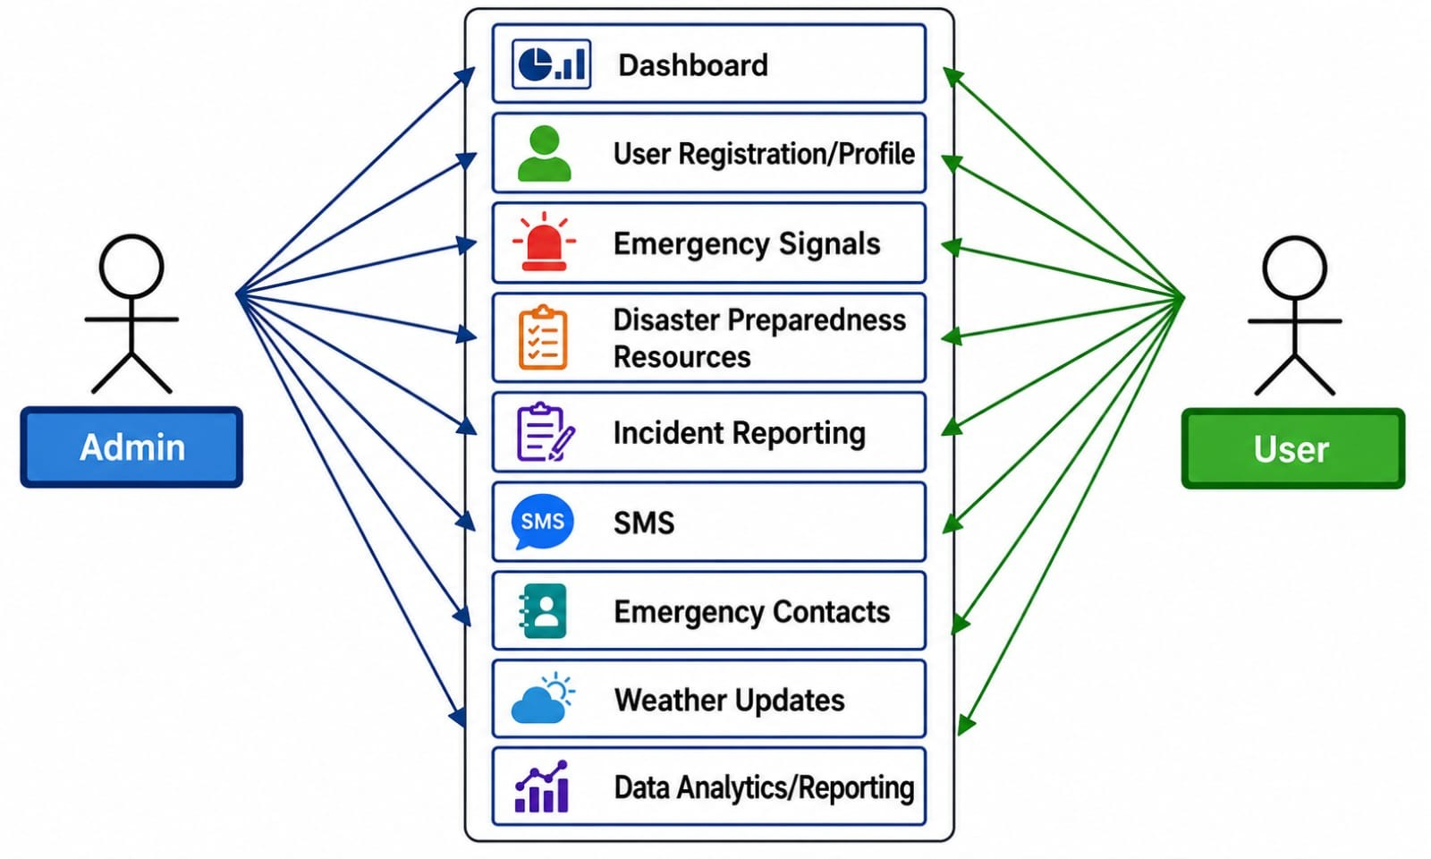
ADMIN ACTIVITY DIAGRAM :

Slide 9
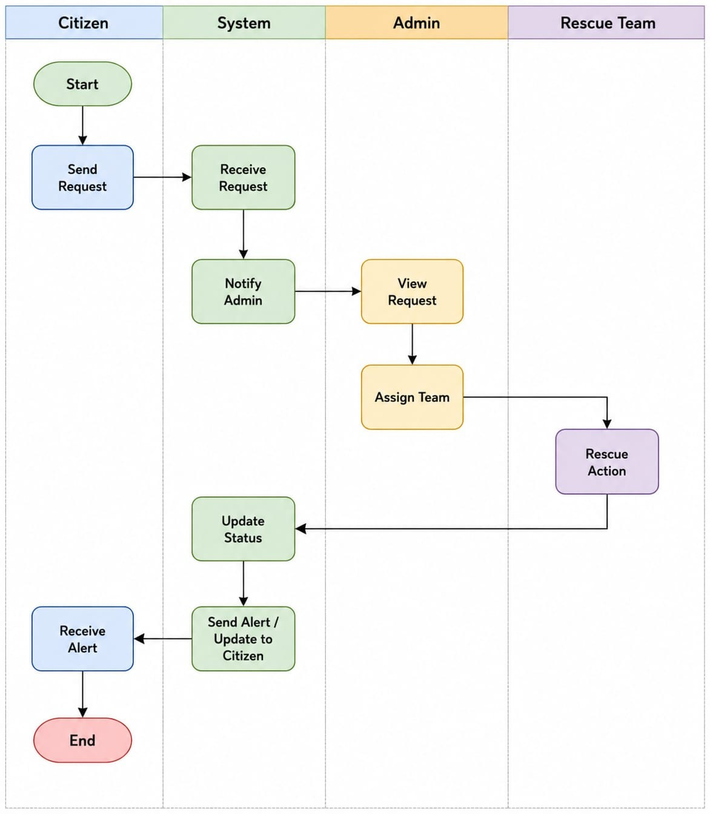
ACTIVITY DIAGRAM :

Slide 10
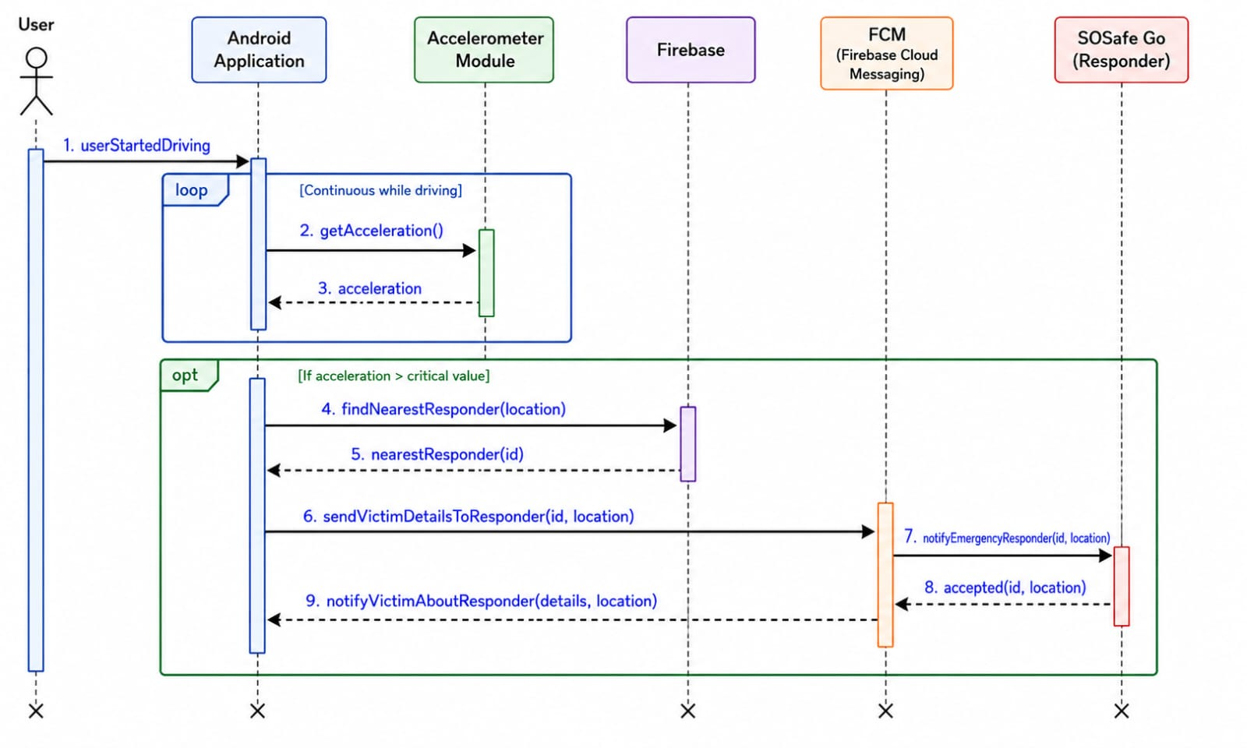
SEQUENCE DIAGRAM :

Slide 11
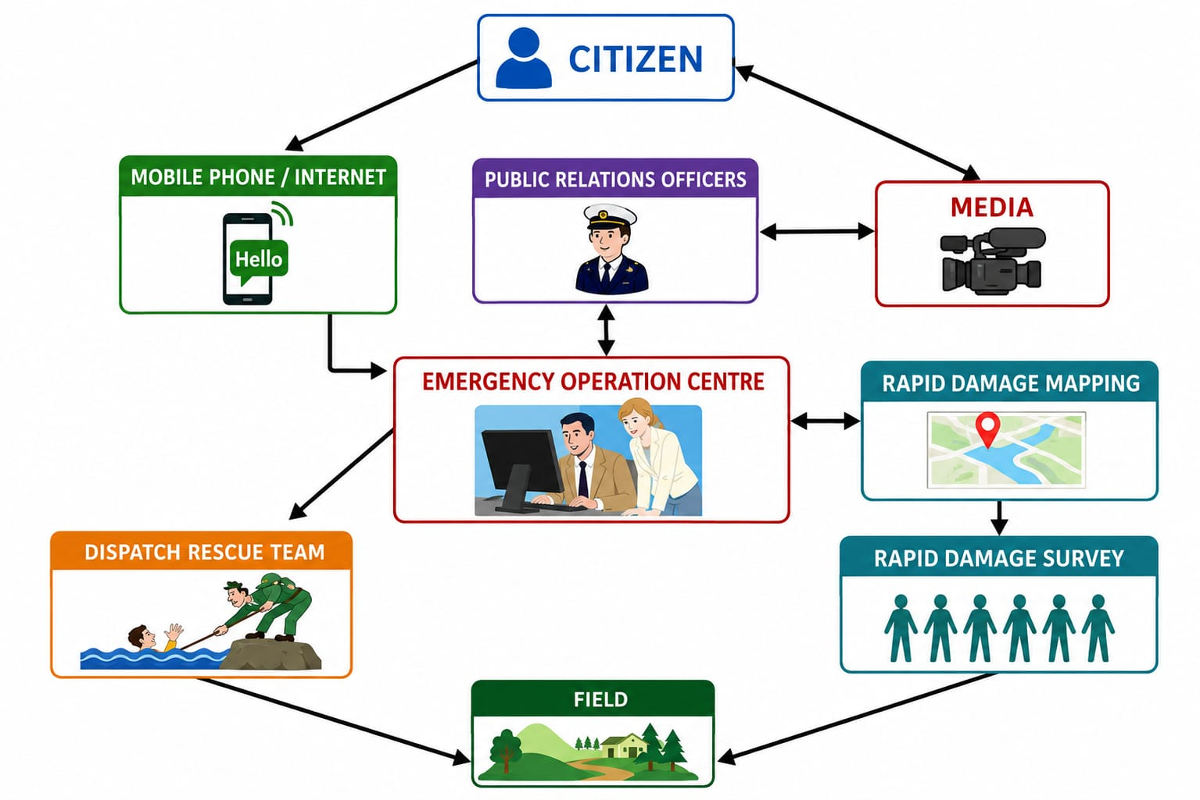
UML COMMUNICATION DIAGRAM :

